Slide 1


Data Insights
Loyalty & Growth
Analyst Team Insights
PRESENTED BY
John Doe

Slide 2

Insights from Data
Over the course of 80 months, we achieved 100% creation rate, with key metrics showing significant growth trends and shipping efficiency, culminating in a late peak of ~6.5K.

Slide 3

Event Coverage Analysis
This section provides insights into the timestamp coverage for various events. It highlights minimum and maximum dates, ensuring a comprehensive understanding of data completeness.

Slide 4

6,500
Orders peaked in August
In August, we observed a significant surge in orders, reaching approximately 6,500. This late peak highlights increasing customer engagement and market demand during this period.

Slide 5

34,005
Total customers in China
China represents the largest customer base, indicating significant engagement and potential for targeted marketing strategies that can further enhance loyalty and sales growth in this region.

Slide 6

$579k
Total revenue from top countries
The major revenue drivers include China, the US, and Brazil, showcasing significant international growth and market potential for our business over the past years.

Slide 7

45–54 years: 38%
Largest age bucket
The majority of our customers fall within the 45–54 age range, indicating a strong market segment that we can further engage through targeted marketing strategies and loyalty initiatives.

Slide 8



Category & SKU Anchors
TOP CATEGORIES
Intimates & Underwear
HERO SKUS
Best-Selling Items
REVENUE HIGHLIGHTS
Leading Products

Slide 9


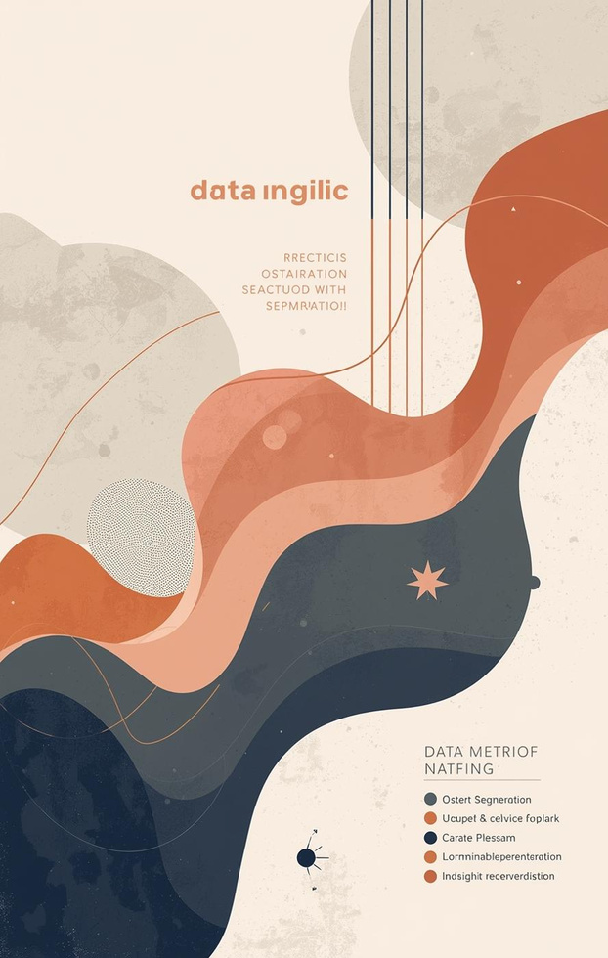
RFM Segments Analysis
AT-RISK SEGMENT
Revenue Share
VIP CUSTOMERS
Revenue Share
OTHER SEGMENTS
Revenue Share

Slide 10

1.50d
Median days to ship
The average time from order creation to shipping is 1.50 days, reflecting efficient operations and prompt processing to ensure customer satisfaction and timely deliveries.

Slide 11

Predictive CLV Approach
This section outlines the methodology for estimating customer lifetime value using BG/NBD and Tweedie models, focusing on a 90-day predictive horizon for actionable insights.

Slide 12

Model Results
This section presents the performance metrics of our predictive models, including MAE and RMSE values, highlighting their effectiveness in forecasting customer lifetime value.

Slide 13

85%
Accuracy of predictions
Our predictive model demonstrates an 85% accuracy, effectively aligning actual customer behavior with forecasted values, enabling strategic targeting and enhanced customer engagement for improved loyalty.

Slide 14

85%
Cumulative revenue captured
This figure represents the total revenue captured through customer engagement strategies, demonstrating the effectiveness of targeted actions in maximizing customer value and loyalty.

Slide 15

Boosting Loyalty & Sales
Implementing targeted strategies such as At-Risk Save and VIP Protection will enhance customer loyalty, increase engagement, and drive revenue growth effectively in our customer base.

